Slide 1
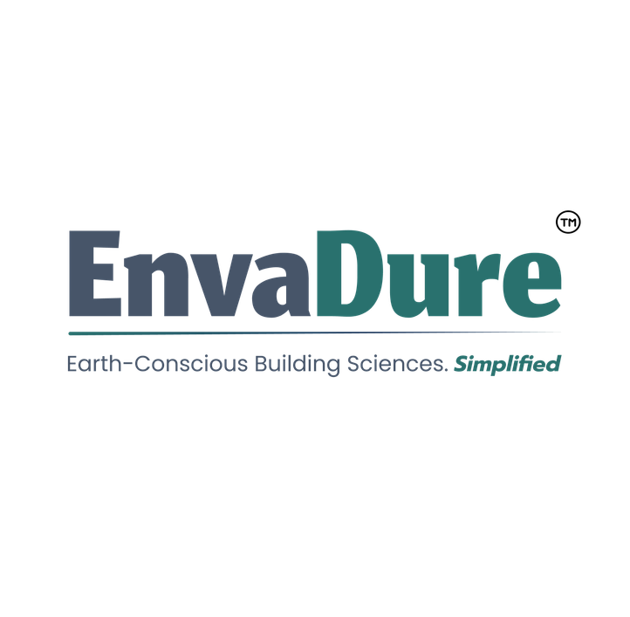
Mehul Parikh

Slide 2
Our Core Positioning :
EnvaDure is the premier, brand-agnostic technical advisory translating complex building science into highly customized, environmentally synced waterproofing specifications for desired structural durability & optimized asset life cycle value.
Strategic Pillars of EnvaDure’s Neutrality :
  Unlike typical specification routes, We operate on radical brand neutrality.
  We do not sell waterproofing products , We engineer risk out of the structure.
  Our allegiance is solely to the structure, maintaining balance between project owner’s interests and environment.

Slide 3
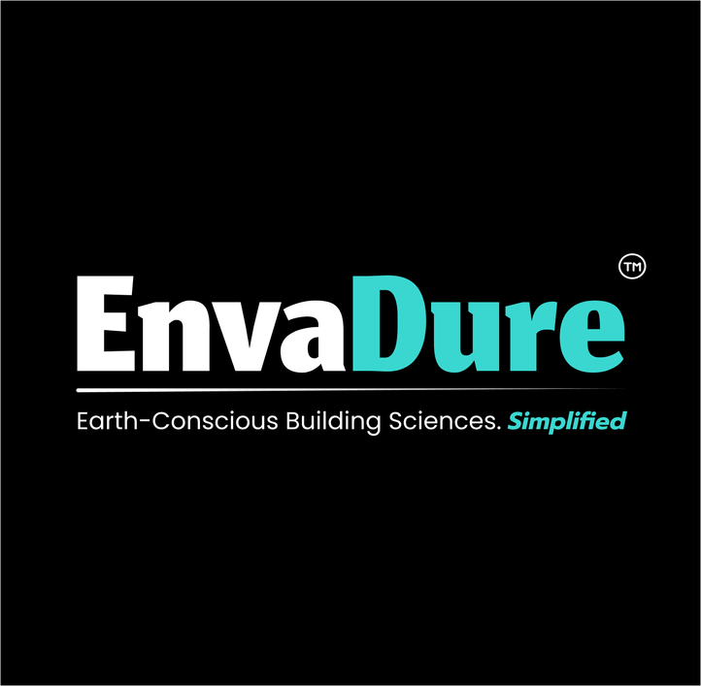
Why do project owners need a specialist waterproofing consultant ?
Building Codes may not always mandate, but now increasingly recommend specialist-level guidance in system design.

Slide 4
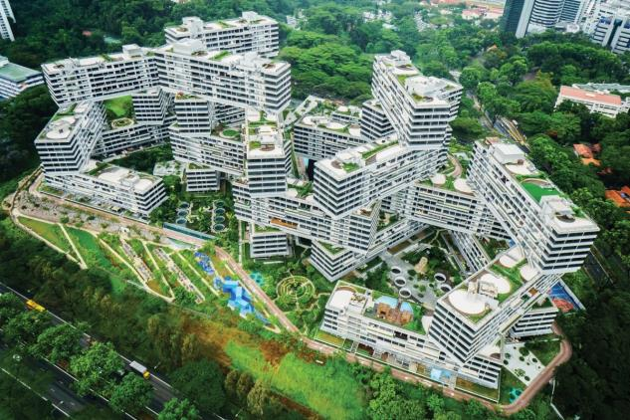
Modern Architecture.
Increasing Structural Complexities.
For Representation purpose Only
Confidential discussion draft
Notes:
Keep this slide crisp. The message is: we convert waterproofing from a product choice into an integrated building-envelope strategy.

Slide 5
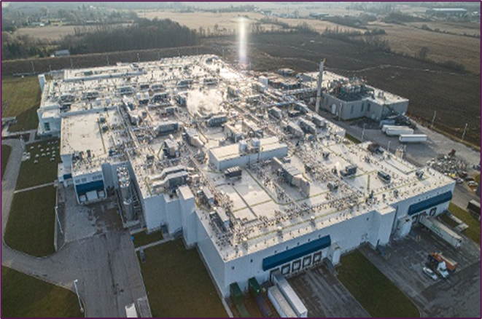
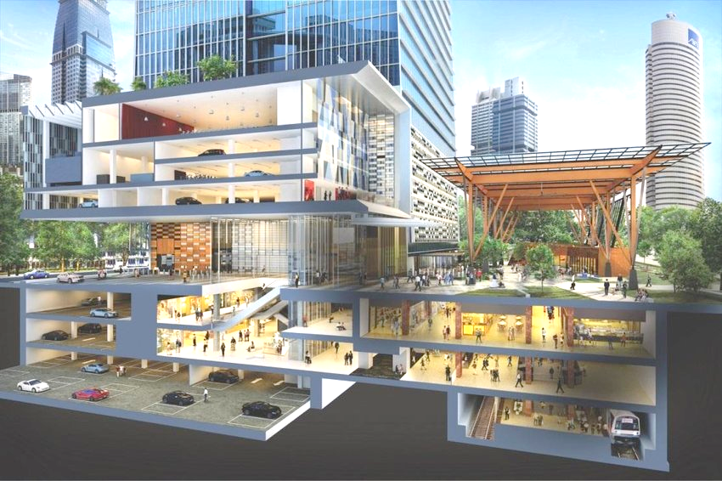
Roofs are Getting Larger and More Complex
Multi-Functional Podiums & Basements…..
For Representation purpose Only
Confidential discussion draft
Notes:
Keep this slide crisp. The message is: we convert waterproofing from a product choice into an integrated building-envelope strategy.

Slide 6
But Why Are We Building 21st-century Structures Using 20th-century Specifications…..
And In A Fundamentally Altered Climate ?

Slide 7

Let’s See What The Climate Is Throwing At Our Structures
India Experienced a 15 fold Increase in Extreme Heat Wave Days Across Mar- May & Jun-Sept Past 3 Decades
1.4 X times Rise in Extreme Rainfall Events in Last 5 Years
4 – 7 x increase in heatwave days by 2050 can be potentially experienced by major Indian cities
Source : Deloitte & Rainmatter – State of Climate Response in India Report
Confidential discussion draft
Notes:
Keep this slide crisp. The message is: we convert waterproofing from a product choice into an integrated building-envelope strategy.

Slide 8
So While India is Building More than Every Other Country in the World ,
Except US and China….
The Question for us is -
How do we build
Leak Free…Sustainable Structures ?
Confidential discussion draft
Notes:
Keep this slide crisp. The message is: we convert waterproofing from a product choice into an integrated building-envelope strategy.

Slide 9
For Most Indians, A Building’s Design & Construction Is Not Experienced Through Landmark Projects, But Unfortunately Often Through :
Leaking roofs resulting in fear of not wanting to buy a top floor apartment,
Fearing to create usable spaces other than car parks in basements,
Uncomfortably hot homes or offices that aren’t well insulated or ventilated,
Dampness from external walls that spoil interior finishes ,
Dark dingy unsafe feeling car parks, etc.

Slide 10
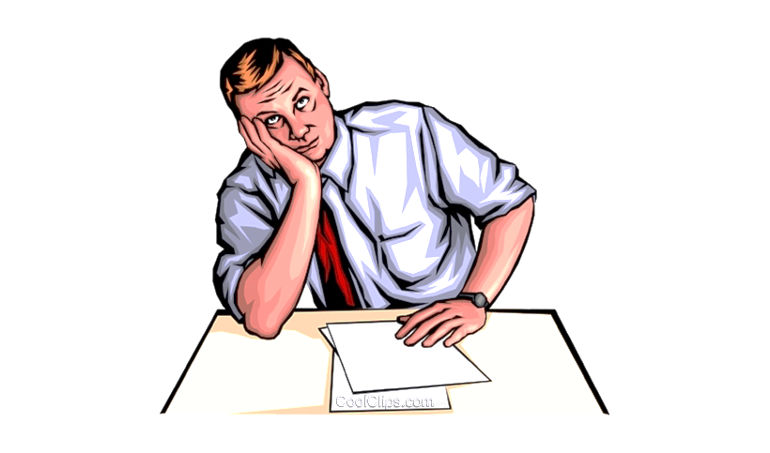
Questions Project Owners often struggle with when waterproofing fails
I Used the same product that performed well in my previous site still……??
Did I choose the Right brand ?
Oh … why didn’t someone explain that –
A proper substrate is essential ?
Improper planning of construction sequence can be disastrous ?
Installed waterproofing shouldn’t be damaged ?
?
#
Did I choose the Right Waterproofing Contractor ?
!
For Representation purpose Only
Notes:
Keep this slide crisp. The message is: we convert waterproofing from a product choice into an integrated building-envelope strategy.

Slide 11
Is our current industry approach correct ?
What comes 1st …. designing a project specific engineered waterproofing specification or directly float a BOQ enquiry ??
Often clients seek offers from multiple product suppliers or applicators - who naturally propose widely differing systems at vastly varying prices !?
A confused client most often awards the contract to an insufficiently designed “cheap” solution !?
Contracts awarded with vague single line BOQ descriptions…..!?
Post award client obviously faces risk of extra items, spec deviations and eventually disputes ???
We want to eat mangoes , but evaluate oranges and then buy a banana ??
Budgets get decided before assessing risks & assessing project performance requirements.
Enquiries are floated for predefined budgets
of Rs. X / Sqm ??
For Representation purpose Only

Slide 12
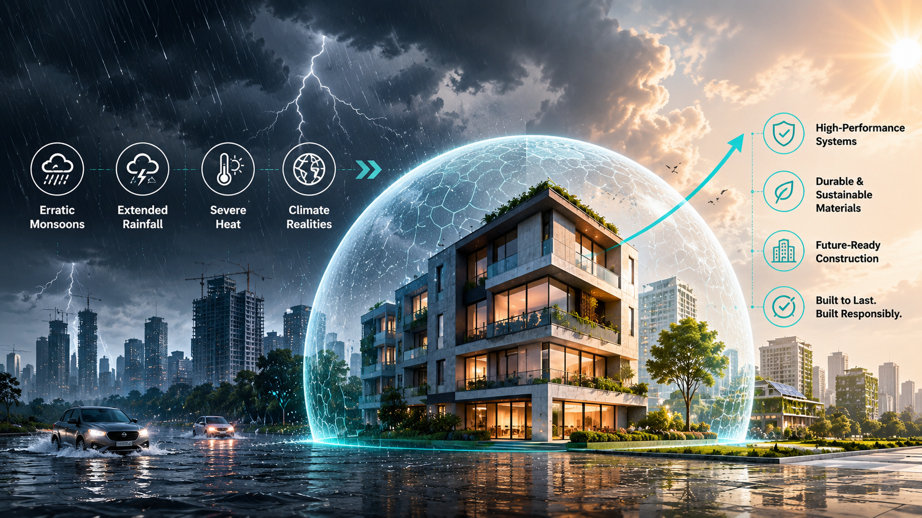
What Needs to Change ?
Structures now need to sustain erratic monsoons, extended rainfall & severe heat
Immediately transition toward high-performance specification designs supported by robustly engineered products that are correctly applied to reliably perform in these conditions !

Slide 13
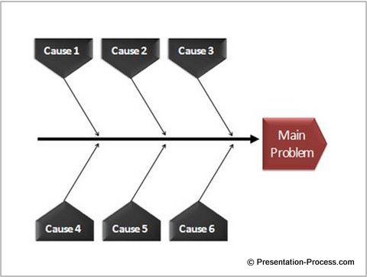
Why do Leakages take place after execution ?
All these factors are responsible in various ways
Product
Process
People
Leakages
Client
Environment
Machine
For Representation purpose Only

Slide 14
Our analysis of ~ 150 projects revealed this !!
Reason for Failure | No. Of Projects | % of Total
Incorrect Application | 58 | 38%
Product Failure | 15 | 10%
Wrong System Selection or Incorrect Specification | 30 | 20%
Post application Damage due to improper sequence clarity | 23 | 15%
Inadequate Skill of technician | 15 | 10%
Improper Substrate due to deficient specification clarity | 11 | 7%
Total | 152 | 100%
A glaring 48 % of leakages were taking place due to Application issues .
Next largest reason 45% was incorrect or deficient specification or wrong system selection.
93 % issues can be avoided !!
Shows importance of correct system selection by a reliable Waterproofing Specialist
For Representation purpose Only

Slide 15
From the Analysis its Clear that Buildings Leak due to 5 fundamental reasons :
Missed out areas of a structure that haven’t been waterproofed.
Wrong Systems Selection or Deficient Specifications
Application Errors
Damage to the installed waterproofing
Poor product quality
Points 1 & 2 - Account for Nearly 45% of Failures, Remaining 3 Account for 55% cases

Slide 16
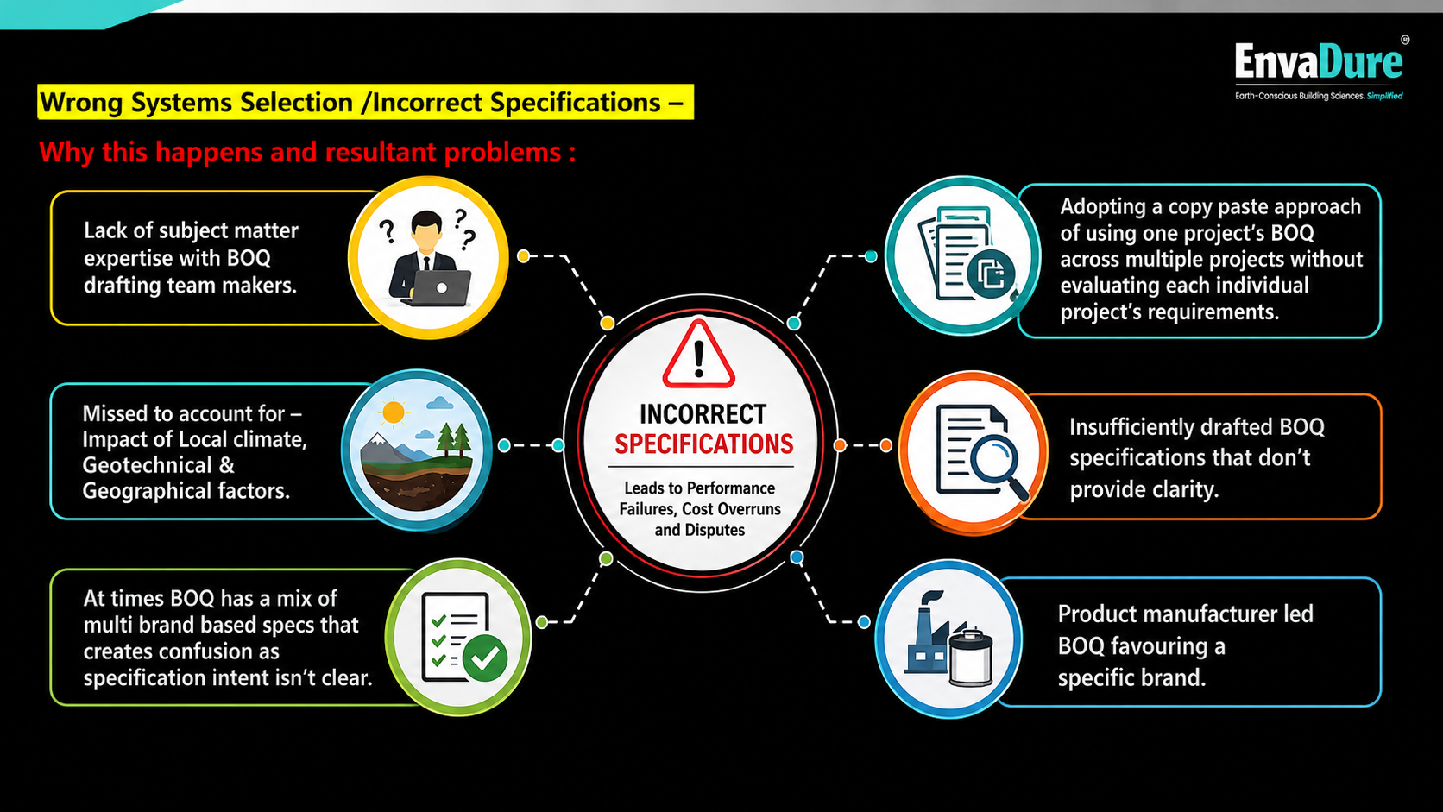
Wrong Systems Selection or Deficient Specifications
Lack of subject matter
expertise among those drafting
BOQ specifications.
Copy-paste approach: same BOQ
used across multiple projects
without evaluating project-specific
requirements.
No thought of local climate, geotechnical/
geographic factors, building use,
Construction methodology, buildability, maintenance
Insufficiently drafted BOQ
specifications; unclear system
build-up and protection layers.
Mixed multi-brand specs causing
confusion on specification
intent.
Single-product manufacturer-led
monopolistic specification.
Notes:
Text was revised using the first slide points while retaining the infographic look and image assets from the second slide. All revised labels are editable text boxes.

Slide 17
1. Missed out areas of a structure that haven’t been waterproofed -
Why this happens and resultant problems :
  Only standard surfaces ( like roofs , toilets , tanks, basement) considered while drafting BOQ – No in-depth study of project’s drawings to identify vulnerable that need waterproofing
  Post award , Cost increases due to extra items getting executed at much higher prices – Typically what costs Re. 1/- during initial design phase estimation – can cost Rs. 2/- if identified later during execution and can cost upto Rs. 10/- as repair costs post hand-over.
  Missed BOQ items or lack of scope clarity can result in potential disputes between Client , contractors, PMC
  Developer’s brand image adversely impacted due – customer’s carry perception that critical areas seem omitted
EnvaDure impact -
Detailed engineering study of architectural and structural drawings , soil investigation report , geographical factors, planned usage , construction technique, future maintenance factors etc for holistic risk assessment to identify all locations that need waterproofing.
Aligned BOQ item list arrived at post detailed study, minimises risk of extra items and missed scope.
Architectural drawings marked up with locations that need waterproofing for easy correlation with BOQ items.

Slide 18
2. Wrong Systems Selection /Incorrect Specifications –
Why this happens and resultant problems :
  Lack of subject matter expertise with BOQ drafting team makers.
  Adopting a copy paste approach of using one project’s BOQ across multiple projects without evaluating each individual project’s requirements.
  Insufficiently drafted BOQ specifications that don’t provide clarity to bidders or project management teams – At times BOQ has a mix of multi brand based specs that creates confusion as specification intent isn’t clear.
  Product manufacturer led BOQ can favour a specific brand – depriving client of a fair bidding process for best value option.
EnvaDure impact -
An independent brand agnostic neutral approach only driven by the project’s requirements.
A scientific approach towards fit for purpose based specifications design based on Indian and International standards and best practices.
Value engineered , Durability and Sustainability driven thought process.
Project biased and not product biased philosophy at the core.
No commercial involvement in entire process of bidding.

Slide 19
3. Erroneous Application done on site –
Why this happens and resultant problems :
  Untrained workmen , Insufficient supervision – outcome of selecting a waterproofing contractor only basis L1 pricing without a proper PQ process.
  Project execution teams not knowing what to check , how to check and when to check during application
  Specifications unclear about dealing with complex locations such as penetrations , interfaces , profile etc
  Lack of clarity in method statements in dealing with complex site conditions.
  No project specific customised cross section drawings available to enable waterproofing contractor and project team to understand intricacy of the waterproofing system installation & build-up at critical points.
  Project teams and applicators unaware about material storage and material handling norms.
EnvaDure impact -
Project specific PQ criteria enabling client to select Waterproofing contractors who have capability to execute.
Detailed cross section drawings for all surfaces / BOQ items and step-wise detailed method statements.
Clearly defined Substrate parameters and ambient factors influencing application.
Clearly defined protocol for on-site tests to be performed.
Easy to implement QAQC check lists for monitoring the work being done by Waterproofing Contractor.

Slide 20
4. Damage to the waterproofing by other agencies –
Why this happens and resultant problems :
  Due to lack of proper activity sequence clarity in the specifications /method statements & unclear HOTO process between agencies.
  Lack of clarity in specifications about how to protect, when to protect and who will do the protection to completed waterproofing.
EnvaDure impact -
Clearly defined scope matrix on technical parameters pertaining to HOTO between Waterproofing Contractor and Main Civil Contractor
Detailed method statements that defined sequential activity with clarity of time intervals involved in succeeding activities.

Slide 21
5. Due to Poor product quality –
Why this happens and resultant problems :
  Lack of Manufacturers Pre-qualification criteria.
  Lack of knowledge in project team about what to check during product approval process, and what to test with testing frequency for product quality.
EnvaDure impact -
A neutral approach towards defining project specific PQ criteria enabling client to select Manufacturers/brands who can supply products meeting specification designs.
Clearly defined performance parameters for product approval
Clearly defined product testing protocols through 3rd party labs.

Slide 22
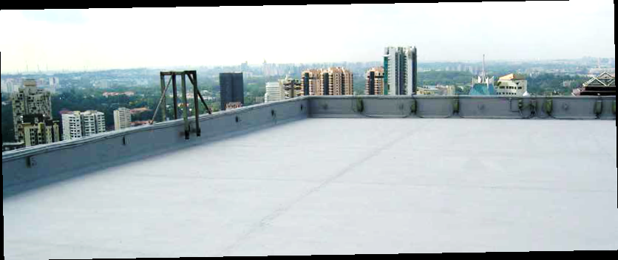
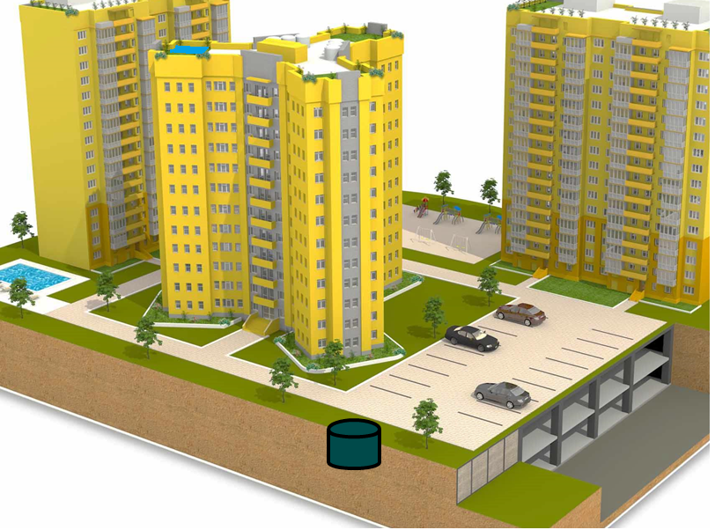
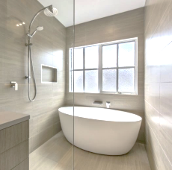

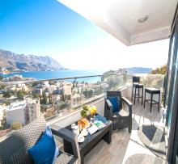
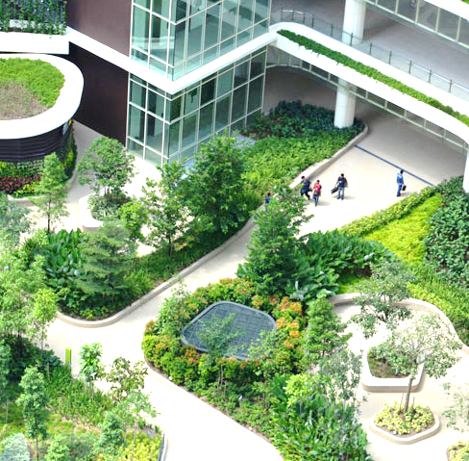
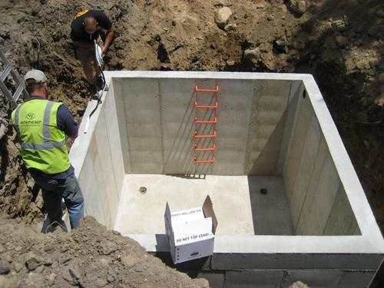
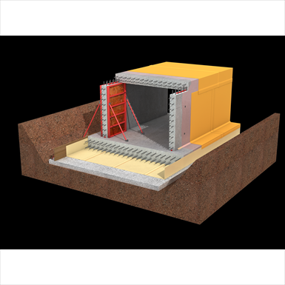
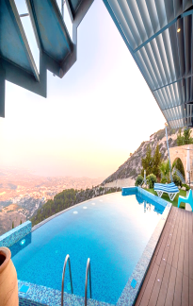
Terrace & Parapet
Balconies / Refuges
Toilet / Kitchens
External Walls
Podium / Driveways / Landscape / Basement Top
Tanks
Basement / UG Structure
Water Bodies / Pools
A structure’s multiple surfaces need fit for purpose Waterproofing – Complex decision making needs a specialist approach
For Representation purpose Only

Slide 23
EnvaDure is not just a BOQ development consulting service -
It’s a truly scientific process driven independent brand agnostic advisory service that enables clients to approach waterproofing requirements for their project backed by experienced expertise enabling project execution teams to carry out work in a properly defined manner resulting in successful outcomes for the overall benefit of the project and it’s occupants.

Slide 24
Our role: independent, brand-agnostic specification intelligence
EnvaDure’s job is to define what performance is required before vendors and contractors compete.
Before tender
During Bid Stage
Study project drawings , geotechnical reports and assess water leakage risks
Devise area-wise system solution strategy
Develop Performance specification clauses
Design Critical detailing and interface matrix
Generate quality check lists
Create customized cross section drawings
Recommend testing protocols
Suggest Pre-qualification criteria
Review PQ compliance by Vendors- compilation by Client team
Shortlisted Vendor Technical Submittal review & alignment with BOQ specifications
Vendor proposed Substitution and equivalent-product evaluation
Participate in Kick off meeting to brief on-boarded vendors
Confidential discussion draft
Notes:
The independence message is crucial. Vendors can support with product data, but they cannot replace project-wide performance specification and neutral comparison.

Slide 25
Our role: independent, brand-agnostic specification intelligence
EnvaDure’s job is to define what performance is required before vendors and contractors compete and Provide the Technical Framework Enabling Client to Select Right Vendors & Enabling PMC team to Monitor Site Execution
What We Don’t DO
Sell Products
Suggest Monopolistic Single Brand Favouring Solutions
Simply Suggest the Most Expensive or the Cheapest – We Only Suggest Fit For Purpose Solutions
Execute the Waterproofing Application Work
Participate in Commercial Discussions with Vendors or Bidders
Supervise or Project Manage the Waterproofing Work on Site.
Certify or Approve Vendor Bills or Payments.
Contract Administration
Confidential discussion draft
Notes:
The independence message is crucial. Vendors can support with product data, but they cannot replace project-wide performance specification and neutral comparison.

Slide 26
Why EnvaDure™ and Mehul Parikh
A rare combination of waterproofing contracting scale, specification insight, system knowledge and execution realism.
Notes:
Position the personal credibility. This is a major differentiator and should not be understated.

Slide 27
Mehul Parikh’s Professional credibility and Relevance
Experience-led independent judgement for high-stakes building-envelope decisions.
30+ yrs
₹300 Cr
3000+
India
Led a Specialised Waterproofing Contracting Business
annual turnover scaled from ~₹1 Cr over leadership period
Pan India Projects exposure across Construction Industry Segments
Deep contextual experience of Indian site conditions, execution practices & client expectations
Profile
Profile
Profile
Profile
What this means for clients
Why it is different
Advice grounded in real project constructability, not theory alone
Ability to anticipate failure modes across design, tender, execution and warranty stages for risk mitigation
Independent, brand-agnostic specifications engineered with a practical execution lens
Collaborative expert support to architects, structural consultants, PMCs and Project Owners
Confidential discussion draft
Notes:
Use this slide to build trust. Avoid sounding like a contractor; frame your track record as the reason you understand both design intent and site failure risk.

Slide 28
A Brief BIO of our Principal Consultant : Mehul Parikh
A BE Civil graduate of 1995 from Pune University.
Former Owner and MD of Nina Percept – India’s largest specialized waterproofing contracting company
Successfully pioneered introduction / adoption in India of several global best practices in waterproofing & specialty construction solutions :-
  Synthetic PP Fibers
  Fully bonded HDPE membranes
  Waterborne Liquid rubber based Waterproofing membranes
  Cold Spray Applied MMA resin based waterproofing
  Epoxy-Polysulphide coatings for Water retaining structures
  EIFS
  PVC-T lock membranes, etc, etc .
Authored and secured a Patent in India for an innovative basement waterproofing system
Co Authored the Hand Book on Waterproofing published by ICI
Member of the BIS Sectional Committee on waterproofing- CED41
Part of a team of industry experts in CIDC drafting essential codes pertaining to waterproofing
Confidential discussion draft
Notes:
The independence message is crucial. Vendors can support with product data, but they cannot replace project-wide performance specification and neutral comparison.

Slide 29
Mehul Parikh –
Unmatched Expertise & Experience in Design & Build of Waterproofing Solutions
A Glimpse of Some Landmark projects that have benefited from Mehul’s Expertise while he led Nina Percept
Notes:
Position the personal credibility. This is a major differentiator and should not be understated.

Slide 30
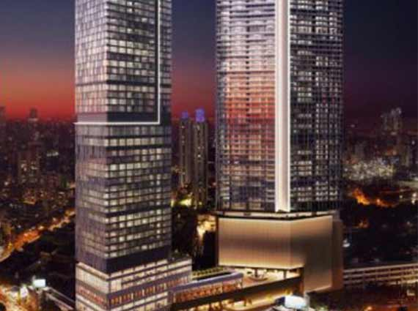
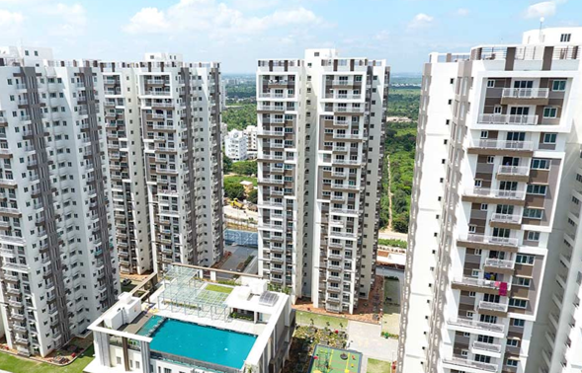
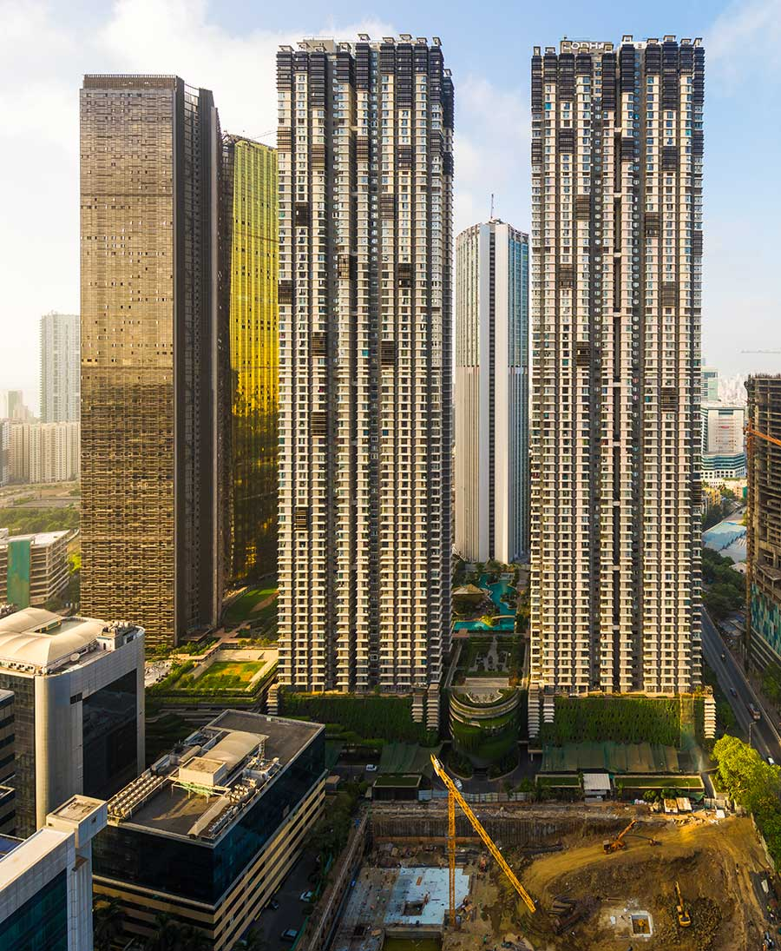
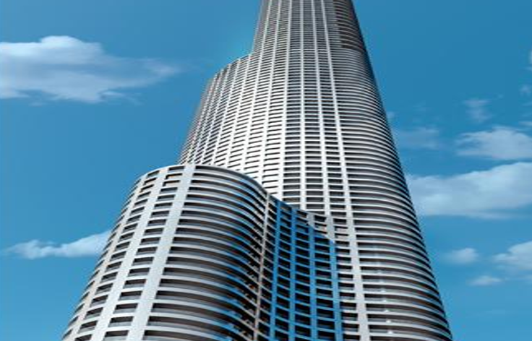
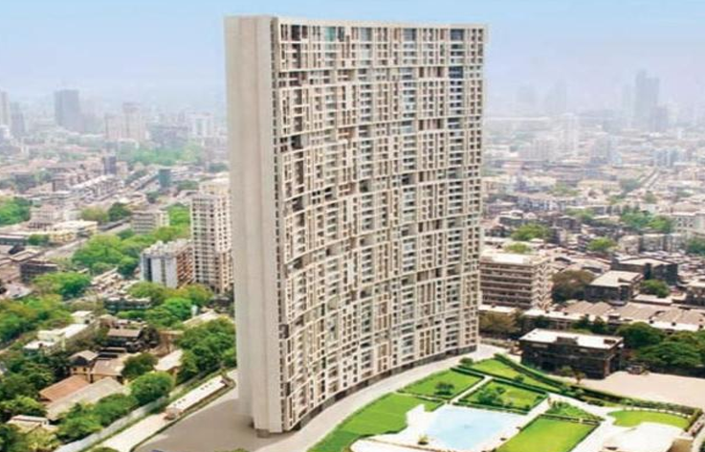
Mehul Parikh – An Unmatched Expertise & Experience Design & Build Solutions based approach
Some Landmark projects that have benefited from Mehul’s Expertise while he led Nina Percept
Premium Residential Projects
Oberoi 360 West Mumbai
Aparna Sarovar, Hyd
Lodha Park, Mumbai
Lodha World One, Mumbai
Godrej Planet, Mumbai
Confidential discussion draft
Notes:
The independence message is crucial. Vendors can support with product data, but they cannot replace project-wide performance specification and neutral comparison.

Slide 31
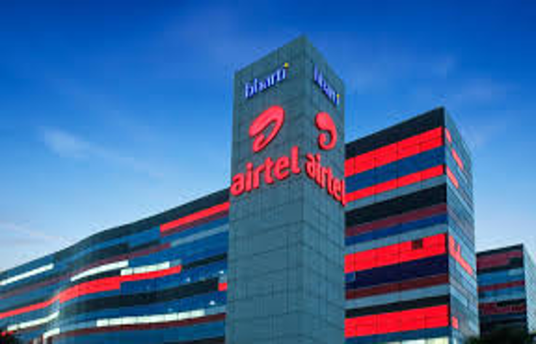
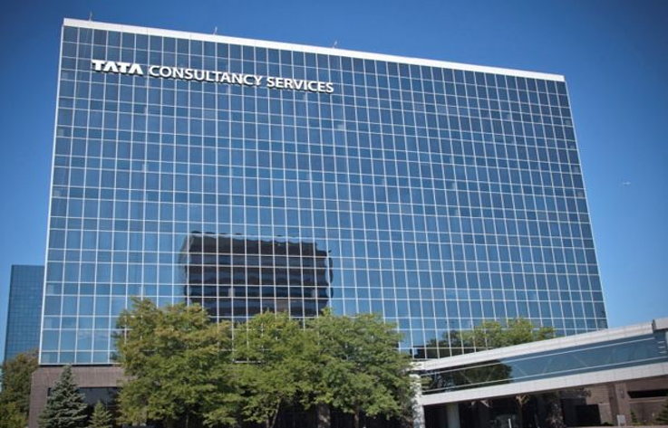
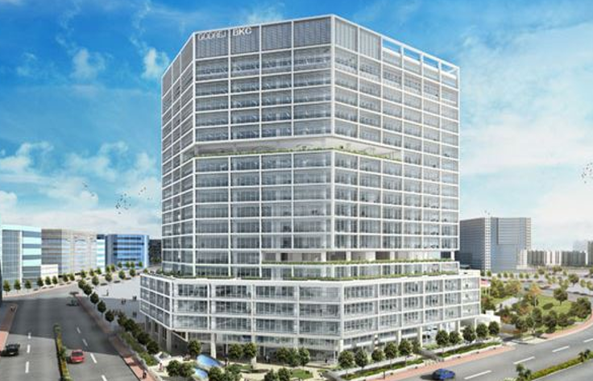

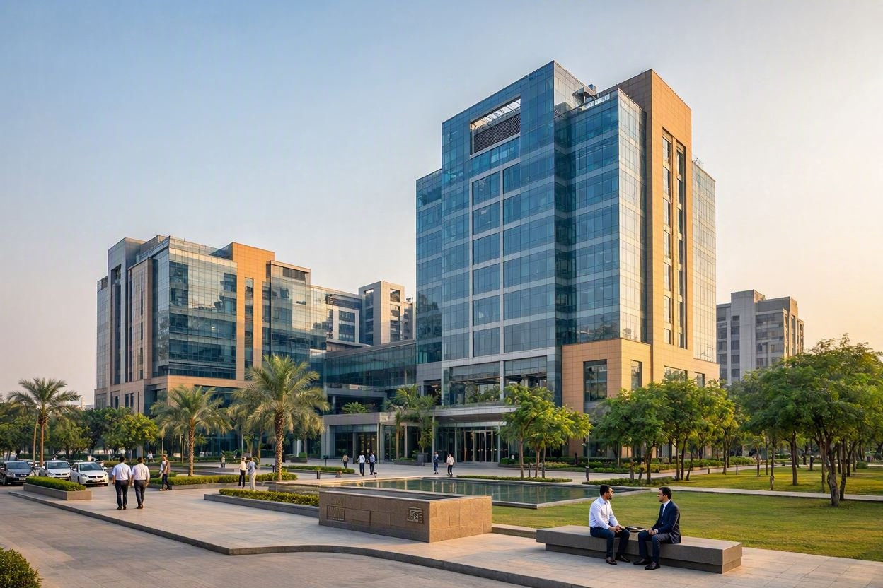
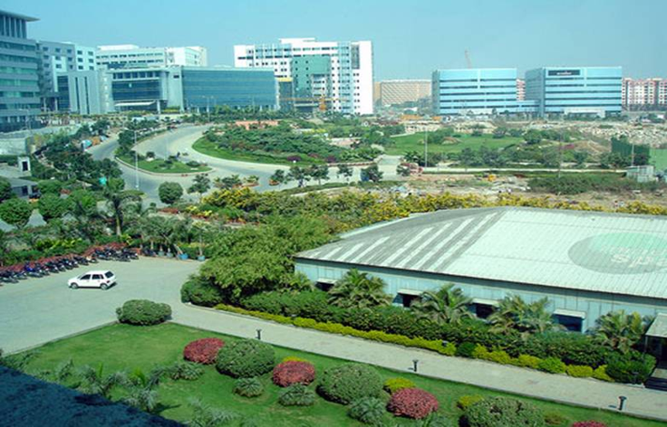
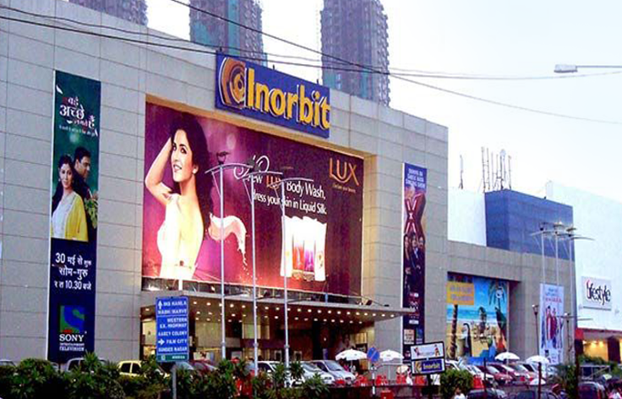
Mehul Parikh – An Unmatched Expertise & Experience Design & Build Solutions based approach
Some Landmark projects that have benefited from Mehul’s Expertise while he led Nina Percept
Commercial Projects
TCS Various Phases , Hinjewadi, Pune
Godrej BKC, Mumbai
Various Bldgs, Mindspace, Mumbai
Inorbit Malls at Malad & Vashi, Mumbai
Various Bldgs, Mindspace Hyd
Confidential discussion draft
Notes:
The independence message is crucial. Vendors can support with product data, but they cannot replace project-wide performance specification and neutral comparison.

Slide 32
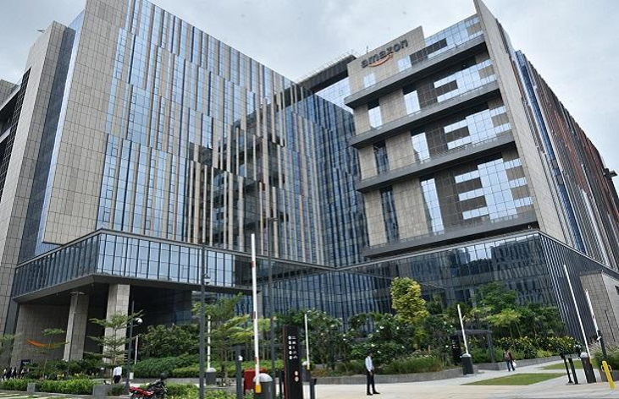
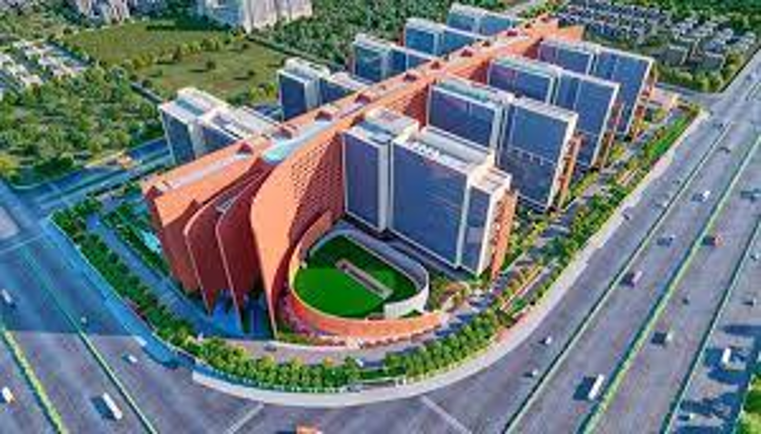
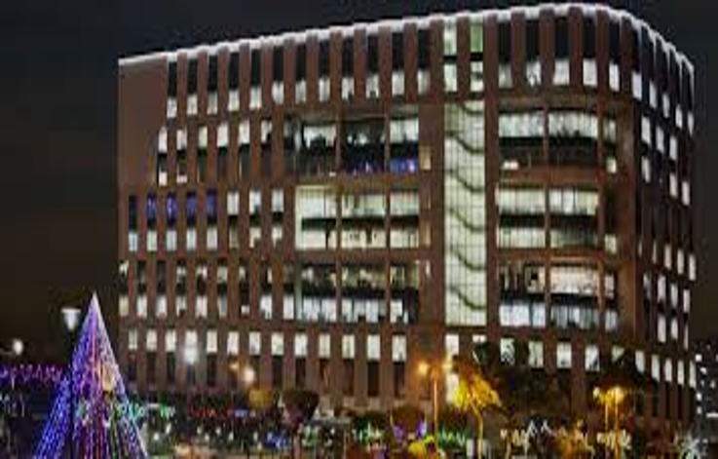
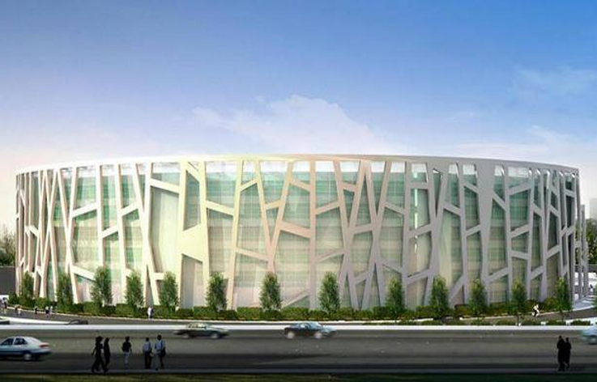
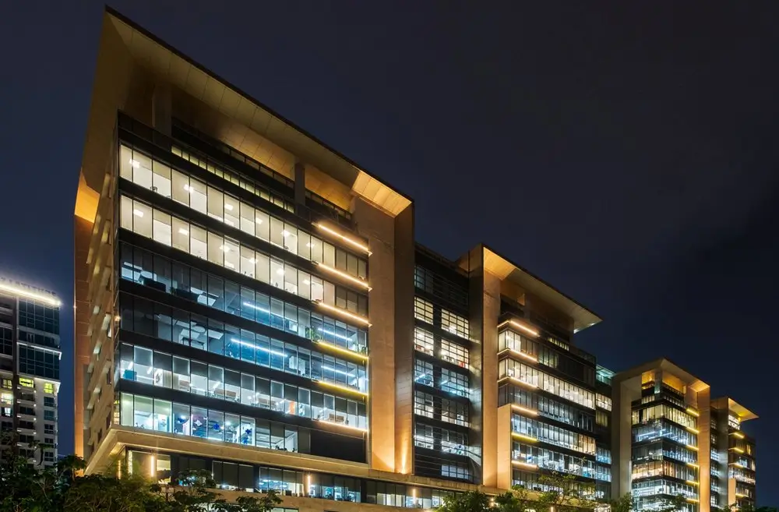
Mehul Parikh – An Unmatched Expertise & Experience Design & Build Solutions based approach
Some Landmark projects that have benefited from Mehul’s Expertise while he led Nina Percept
Commercial Projects
Amazon , Hyd
Surat Diamond Bourse, Surat
Candor techspace, Kolkata
ONGC, New Delhi
Brigade magnum, Bengaluru
Various Bldgs, Mindspace Hyd
Confidential discussion draft
Notes:
The independence message is crucial. Vendors can support with product data, but they cannot replace project-wide performance specification and neutral comparison.

Slide 33
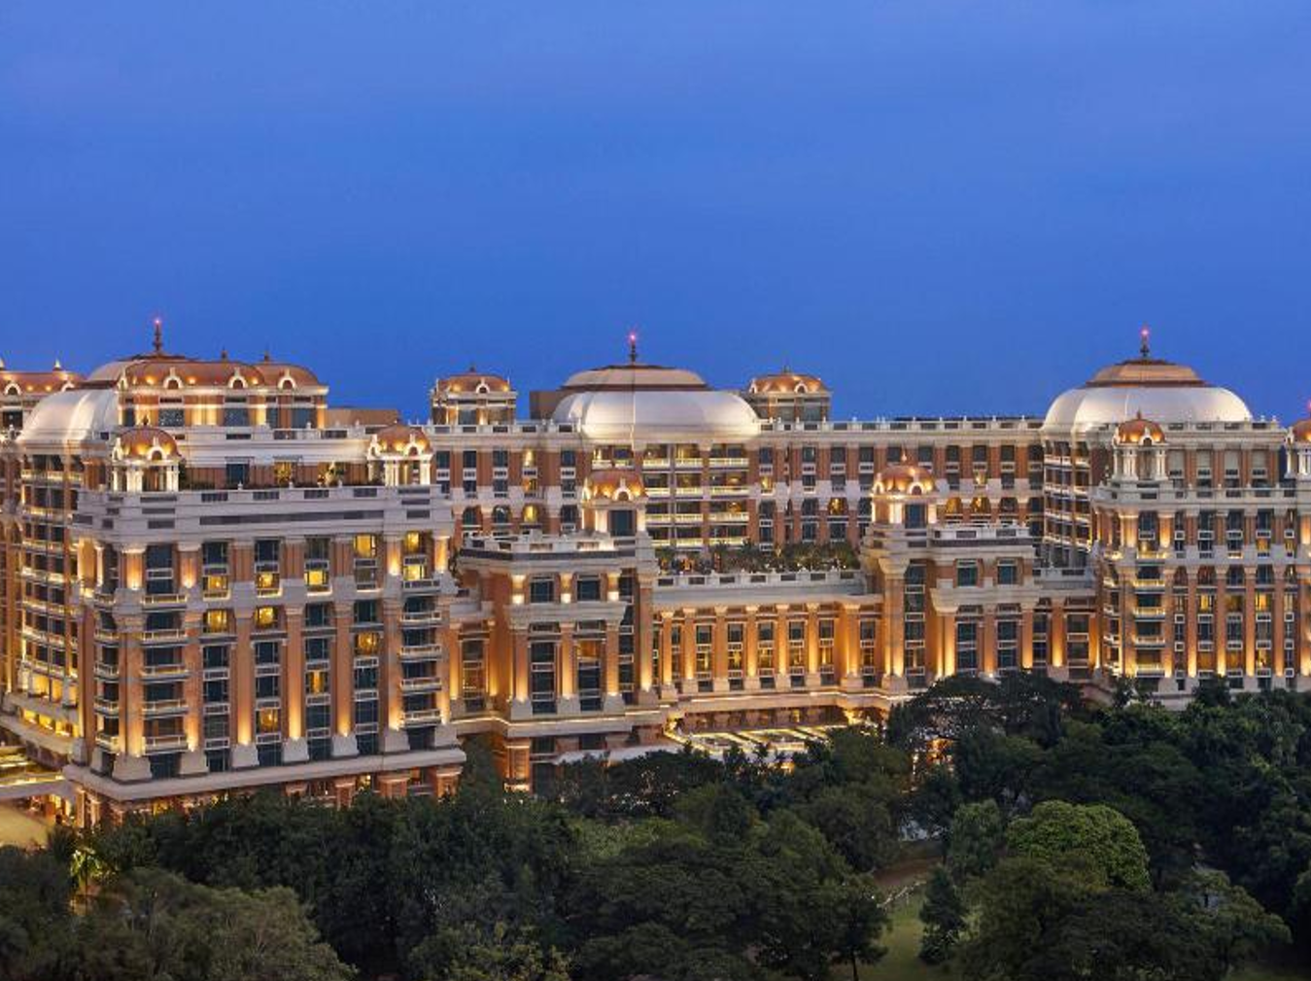
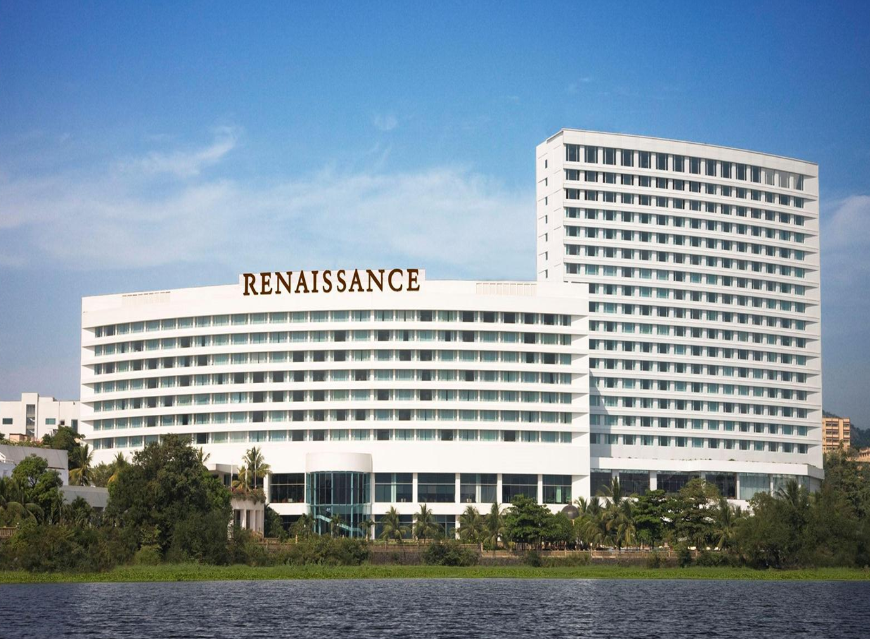
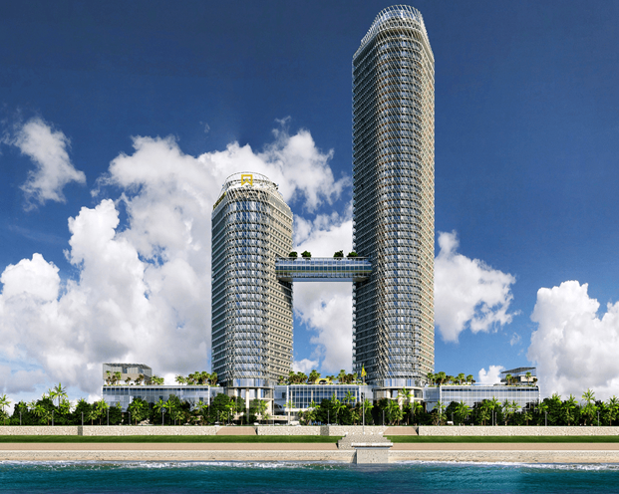
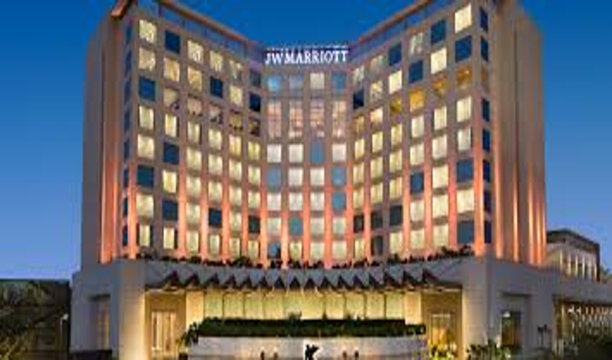
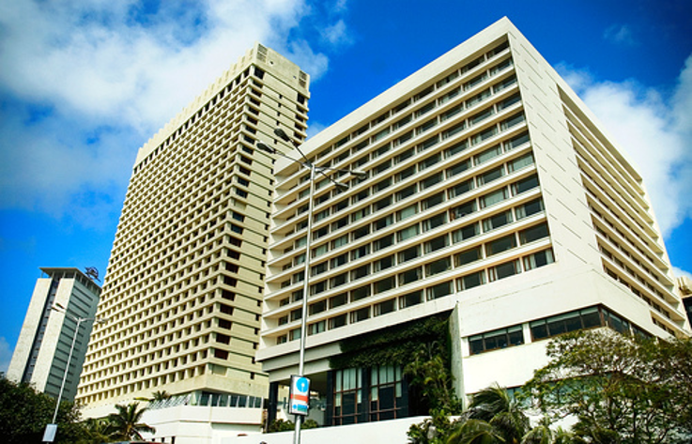
Mehul Parikh – An Unmatched Expertise & Experience Design & Build Solutions based approach
Some Landmark projects that have benefited from Mehul’s Expertise while he led Nina Percept
Hospitality Projects
Westin, Powai , Mumbai
ITC Chola , Chennai
ITC One Colombo
JW Marriott, Mumbai
Oberoi Trident, Mumbai
Confidential discussion draft
Notes:
The independence message is crucial. Vendors can support with product data, but they cannot replace project-wide performance specification and neutral comparison.

Slide 34
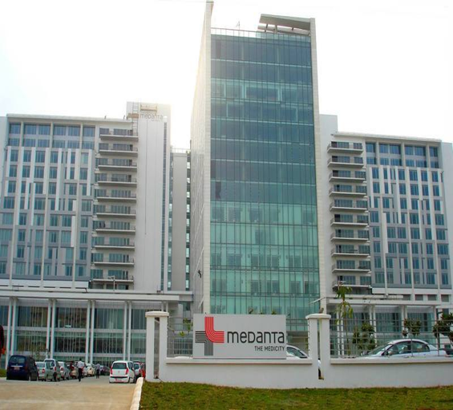
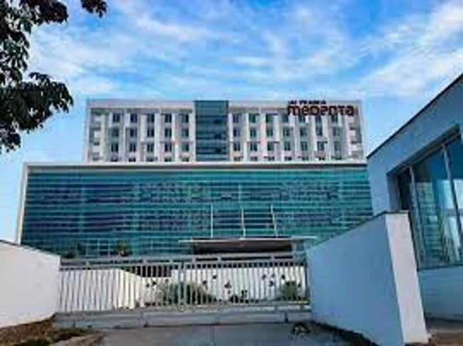
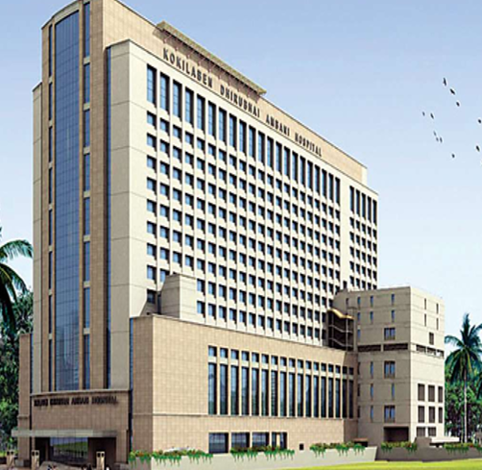
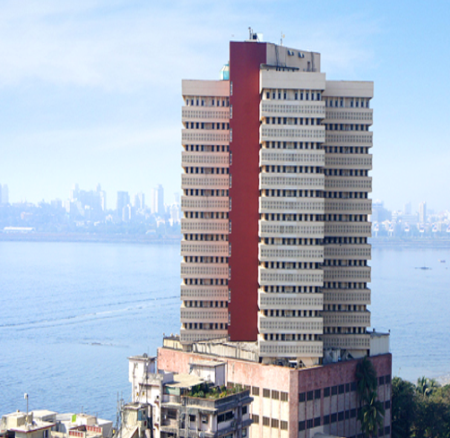
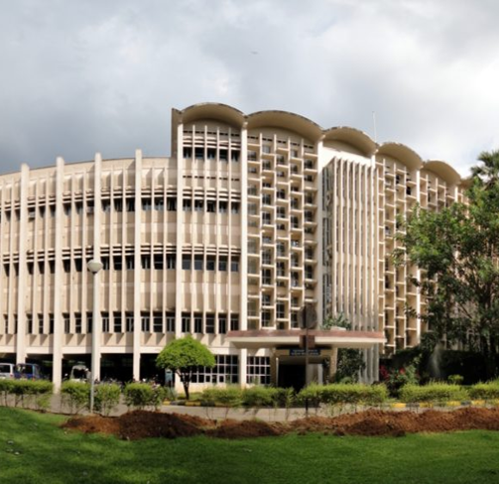
Mehul Parikh – An Unmatched Expertise & Experience Design & Build Solutions based approach
Some Landmark projects that have benefited from Mehul’s Expertise while he led Nina Percept
Healthcare Projects
Medanta, Lucknow
Medanta Hospital, Patna
Kokilaben Ambani Hospital, Mumbai
Hinduja Hospital, Mumbai
Jupiter Hospital, Pune
Confidential discussion draft
Notes:
The independence message is crucial. Vendors can support with product data, but they cannot replace project-wide performance specification and neutral comparison.

Slide 35
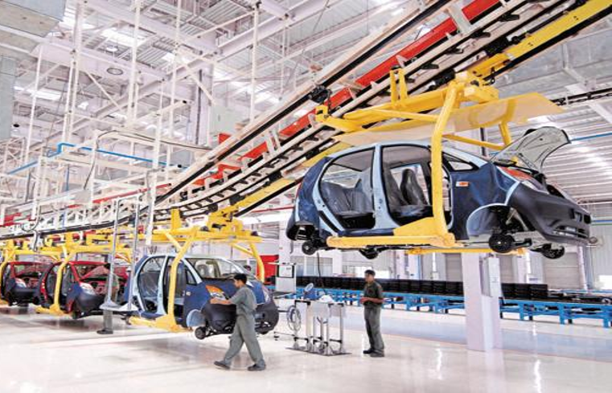
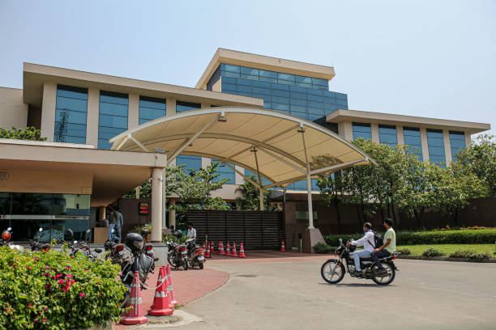
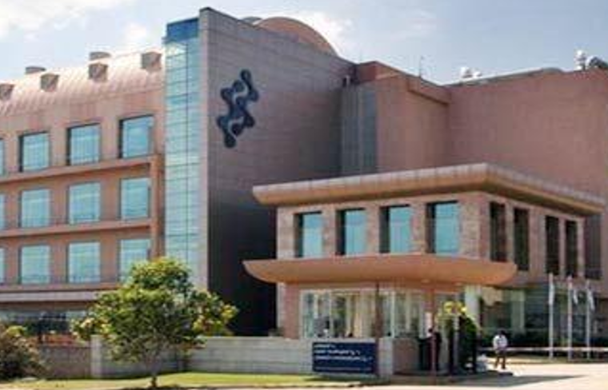

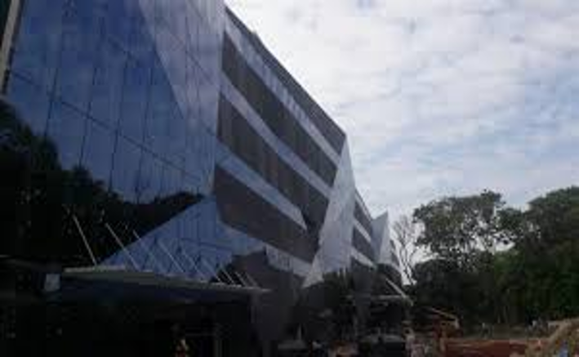
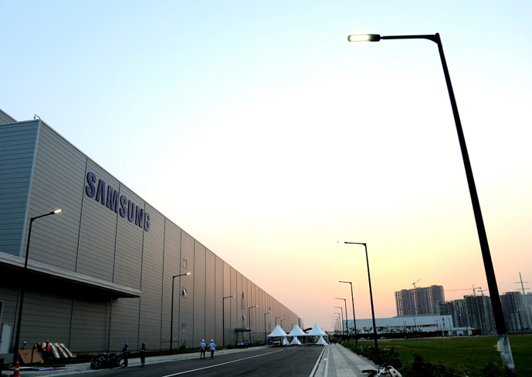
Mehul Parikh – An Unmatched Expertise & Experience Design & Build Solutions based approach
Some Landmark projects that have benefited from Mehul’s Expertise while he led Nina Percept
Industrial Projects
Tata Motors, Multiple Locations
Serum Institute , Pune
Biocon , Bengaluru
USV Ltd, Multiple Locations
Tata Cummins, Pune
Samsung Mobile Plant, NCR
Confidential discussion draft
Notes:
The independence message is crucial. Vendors can support with product data, but they cannot replace project-wide performance specification and neutral comparison.

Slide 36
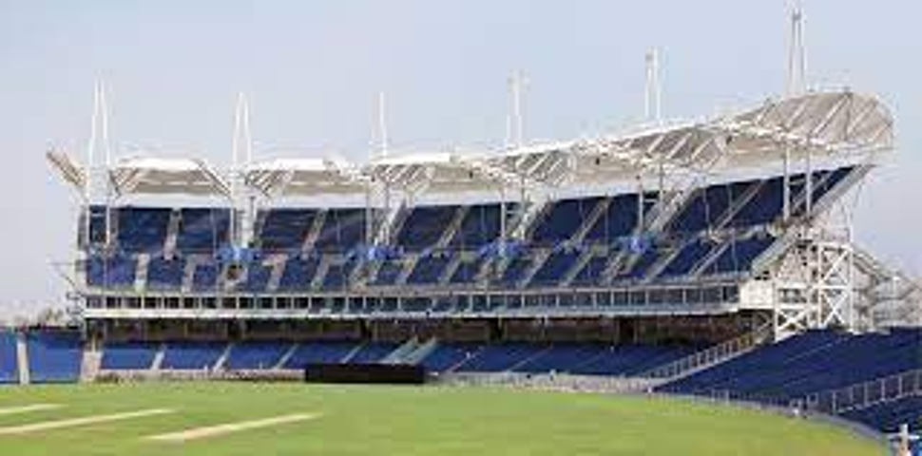
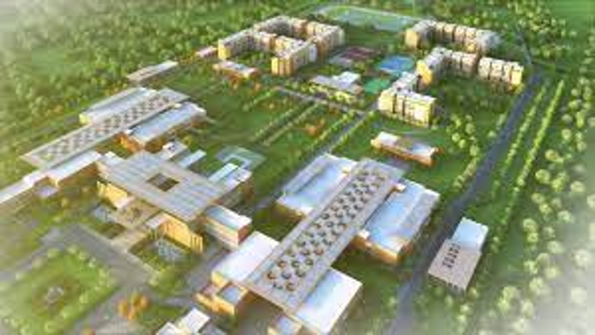


Mehul Parikh – An Unmatched Expertise & Experience Design & Build Solutions based approach
Some Landmark projects that have benefited from Mehul’s Expertise while he led Nina Percept
Educational and Sports Projects
MCA Stadium, Pune
IIM Nagpur
MCGM Swimming Pool Complex, Mumbai
IIT, Hyd
Confidential discussion draft
Notes:
The independence message is crucial. Vendors can support with product data, but they cannot replace project-wide performance specification and neutral comparison.

Slide 37
The unique EnvaDure Seven-Dimensional Specification Design Approach Matrix
1. Geography & Geotechnical Profile
The Science: Analysis of soil geochemistry (pH levels, sulfate/chloride concentrations, etc and hydrological dynamics (static hydraulic pressure vs. dynamic perched water tables).
The Specification Impact: Choosing a membrane that can withstand high chemical attacks without depolymerizing.
2. Structural & Asset Usage
The Science: Tailoring the dry-envelope requirement based on interior usage classes (e.g., Grade 1 for basements with open parking structures vs. Grade 3 for hyper-sensitive data centers or habitable basements with offices or shops ).
The Specification Impact: Designing multi-tier redundant barrier systems (Type A barrier + Type B integral + Type C drained protection) for critical zones.
3. Climate & Microclimate Dynamics
The Science: Designing for solar exposure, UV degradation rates, temperature fluctuations ( ), wind-driven rain vectors, and thermal expansion-contraction cycles.
The Specification Impact: Specifying high-elasticity, crack-bridging liquid membranes in high-thermal fluctuation zones vs. robust sheet membranes for subterranean, temperature-stable basements.
Confidential discussion draft
Notes:
Keep this as a reference slide. If the client wants source backup, you can provide the detailed research memo separately.

Slide 38
The unique EnvaDure Seven-Dimensional Specification Design Approach Matrix
4. Energy Efficiency & Thermal Synergy
The Science: Aligning the waterproofing barrier with insulation components (value requirements) and vapor control layers to prevent interstitial condensation.
The Specification Impact: Specifying cool-roof, highly reflective waterproofing coatings to lower building HVAC energy consumption.
5. Value Engineering
The Science: Optimizing initial capital expenditure ( ) versus long-term operational and remedial maintenance expenditures.
The Specification Impact: Recommending a hybrid system—spending premium dollars on inaccessible, critical below-grade areas while utilizing highly cost-effective, easily repairable systems for above-grade podiums.
6. Sustainability & Environmental Footprint
The Science: Reducing VOC emissions, utilizing recycled polymer content, and optimizing the carbon footprint of the waterproofing system over its lifetime.
The Specification Impact: Prioritizing solvent-free, non-toxic, and LEED-compliant systems that do not contaminate local groundwater systems.
7. Long-Term Durability Criteria
The Science: Matching the service life expectancy of the waterproofing system with the design life of the structural concrete
The Specification Impact: Eliminating materials with a high rate of early-onset oxidation or embrittlement to prevent premature structural decay.
Confidential discussion draft
Notes:
Keep this as a reference slide. If the client wants source backup, you can provide the detailed research memo separately.

Slide 39
Contact Us
Mehul Parikh
Cell : +919867524600
Email : mehul@envadure.com
Linked In : http://linkedin.com/in/mehul-parikh-47144579

